Slide 1
Lecture 10a
The Network Layer (1): The Internet Protocol

Slide 2
Internetworking
?
Before Internet: different packet-switching networks (e.g., ARPANET, IBM SNA, Ethernet, packet radio, etc.)
Only nodes on the same network could communicate
Principal focus of Network Layer in protocol stack
How to allow independently owned and administered networks to interconnect?
Two nodes communicating across a “network of networks”…
How to transport information through this heterogeneous mess ?
This was one of the key drivers of the Internet in the 1980s
?

Slide 3
The Internetworking Problem
Problems: heterogeneity and scaling
Heterogeneity:
How to interconnect a large number of disparate networks ? ( different lower layers)
How to support a wide variety of applications ? (different upper layers)
Scaling:
How to support a large number of end-nodes and applications in this interconnected network ?

Slide 4
Internet Solution to Internetworking
Network Layer
Gateways

Slide 5
The Internet Solution …
IP
IP
IP
IP
Network layer gateways & global addresses
Simple, application-independent, lowest denominator network service based on datagram based packet switching
Stateless gateways called “routers” can easily route around failures
Define a new protocol Internet Protocol(IP) and map all applications/networks to IP
IP independent of lower layer network technology

Slide 6
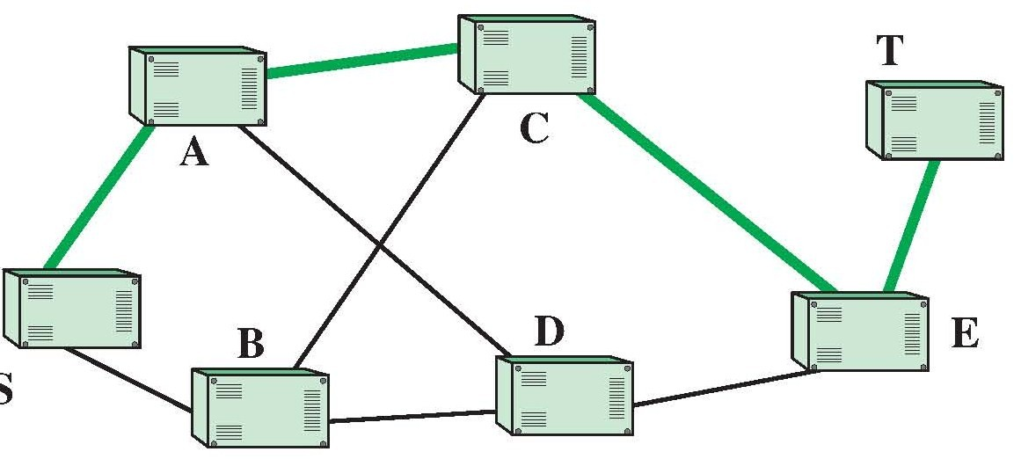
Switching Methods
Three general approaches to moving information through multi-node interconnected networks
Circuit Switching
Dedicates “network” resources, blocking, pay per minute
Need signaling to teardown path when done
Wastes the resources when the load is light
Message Switching
Packet Switching

Slide 7
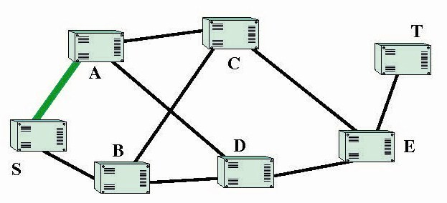
Message switching
General
Transmission is one node at a time (entire path is not dedicated)
Uses delay to mediate contention

Slide 8
Packet switching
Similar in principal to message switching
Uses delay to mediate contention
Transmission is one node at a time
Messages broken into pieces called packets and each packet is transmitted one at a time
Supports
Multiprocessing: Simultaneously transmits the previously received packet as it is receiving the next packet. Message switches cannot do this because they must receive the entire message before retransmitting it.
Pipelining: Packets from same message can be in transit on multiple links simultaneously

Slide 9
Circuit vs. Packet vs. Message Switching
Time
Packet 1
Packet 2
Packet 3
message
Circuit Switching
Message Switching
Packet Switching
Notes:
Packet Switching obtains its benefit by multiprocessing. That is, it simultaneously transmits the previously received packet as it is receiving the next packet. Message switches cannot do this even if they are constructed to because they must receive the entire message before retransmitting it. If several separate messages are being transmitted in sequence, the message switch can multiprocess, but that does not help an individual message.

Slide 10
Comparing switching techniques
Type | Contention mgt | Bandwidth | Delay components | Comments
Circuit | Blocking | Use only a slice of bandwidth, but all the time | Call setup Propagation Transmission | Call setup > 2* propagation
Message | Delay | Use full link bandwidth, but only for message | Queueing Propagation Transmission | Entire message received & transmitted at each node
Packet | Delay | Use full link bandwidth, but only for packet | Queueing Propagation Transmission | Each packet received & transmitted at each node

Slide 11
Two ways for Packet switching
Connection Oriented (virtual circuit)
Set up route between source and destination of communication
All packets go on same route
Can “reserve” or not - the resources on the route
Source routing in IP?
Connection-less (datagram)
Route each packet independently through the network
No reserved resources – no guarantees of service quality

Slide 12
Connection Oriented Service
Before data flows, two end hosts and intervening network components establish connection or virtual connection (VC)
Need signaling protocol to setup, maintain teardown VC
Each packet has VC ID in header – decision based on ID
Used in ATM, frame-relay, X.25
application
transport
network
data link
physical
5. Data flow begins
6. Receive data
application
transport
network
data link
physical
4. Call connected
3. Accept call
1. Initiate call
2. incoming call

Slide 13
Datagram (IP) networks
No call setup at network layer
Network components retain no state about end-to-end connections
No network-level concept of “connection”
Packets forwarded using destination host address
Packets between same source-dest pair may take different paths
application
transport
network
data link
physical
application
transport
network
data link
physical
1. Send data
2. Receive data

Slide 14
Internet History
Evolved from ARPANet (Defense Department’s Advanced Research Projects Agency Network)
ARPANet was developed in 1969, and was the first packet-switching network
Initially, included only four nodes: UCLA, UCSB, Utah, and SRI
Key points
ARPAnet/Internet was a general purpose network (i.e., was not optimized for a particular application)
Used delay to mediate contention for resources
See: https://www.internetsociety.org/sites/default/files/GUIS-2012-Infographic.pdf

Slide 15
Commercial Internet Use
ARPANet and NSF limited use to research and development
Early commercial use primarily information dissemination
Electronic transactions gradually moved to the Internet
WWW growth in 1990s led to increased direct sales over Internet
Growth has led to the expansion of data mining for target marketing

Slide 16
Internet structure: network of networks
Slide modified from Kurose & Ross
End systems connect to Internet via access ISPs (Internet Service Providers)
Residential, company and university ISPs
Access ISPs in turn must be interconnected.
So that any two hosts can send packets to each other
Resulting network of networks is very complex
Evolution was driven by economics and national policies
We take a stepwise approach to describe current Internet structure
RFC = Request for Comments – specifies internet related standards
Developed by IETF – Internet Engineering Task Force

Slide 17
Functions of the Network layer
Slide modified from Agrawal
Transfer variable length data packets from a source network to a destination network via one or more networks
Can optionally maintain different qualities of service (QoS)
Term used to denote different application requirements
This task is called Routing
Performed in the network by devices called Routers
Notes:
IP focuses on the job of routing data, in the form of IP packets, from the source host to the destination host. IP does not concern itself with the physical transmission of data, instead relying on the lower TCP/IP layers to do the physical transmission of the data. Instead, IP concerns itself with the logical details, rather than physical details, of delivering data. In particular, the network layer specifies how packets travel end to end over a TCP/IP network, even when the packet crosses many different types of LAN and WAN links.

Slide 18
Network and Link Layers
Figure modified from Agrawal
Look at the destination link (DL) address (how it changes)
Observe that the IP destination address does not change

Slide 19
Internet structure: network of networks
Slide modified from Kurose & Ross
Recall from long long ago…
…
…
access
net
access
net
access
net
access
net
access
net
access
net
access
net
…
…
Question: given millions of access ISPs, how to connect them together?
access
net
access
net
access
net
access
net
access
net
access
net
…
access
net
access
net
…
access
net

Slide 20
Slide modified from Kurose & Ross
Option: connect each access ISP to every other access ISP?
…
…
access
net
access
net
access
net
access
net
access
net
…
…
access
net
access
net
…
connecting each access ISP to each other directly doesn’t scale: O(N²) connections.
…
…
access
net
access
net
…
access
net
access
net
access
net
…
access
net
…
access
net
access
net
…
access
net

Slide 21
Slide modified from Kurose & Ross
Option: connect each access ISP to a global transit ISP? Customer and provider ISPs have economic agreement.
…
…
access
net
access
net
access
net
access
net
access
net
access
net
access
net
…
…
global ISP
access
net
access
net
access
net
access
net
access
net
access
net
…
access
net
access
net
…
access
net

Slide 22
Slide modified from Kurose & Ross
But if one global ISP is viable business, there will be competitors ….
…
…
access
net
access
net
access
net
access
net
access
net
access
net
access
net
ISP A
…
…
access
net
ISP B
access
net
ISP C
access
net
access
net
access
net
access
net
…
access
net
access
net
…
access
net

Slide 23
Slide modified from Kurose & Ross
But if one global ISP is viable business, there will be competitors …. which must be interconnected
Internet exchange point
…
…
access
net
access
net
access
net
access
net
access
net
IXP
access
net
access
net
ISP A
…
…
IXP
access
net
access
net
ISP B
ISP C
access
net
access
net
peering link
access
net
access
net
…
access
net
access
net
…
access
net

Slide 24
Slide modified from Kurose & Ross
… and regional networks may arise to connect access nets to ISPS
…
…
access
net
access
net
access
net
access
net
access
net
IXP
access
net
access
net
ISP A
…
…
IXP
access
net
access
net
ISP B
ISP C
access
net
access
net
access
net
regional net
access
net
…
access
net
access
net
…
access
net

Slide 25
Slide modified from Kurose & Ross
… and content provider networks (e.g., Google, Microsoft, Akamai ) may run their own network, to bring services, content close to end users
…
…
access
net
access
net
access
net
access
net
access
net
IXP
access
net
access
net
ISP A
…
…
Content provider network
IXP
access
net
access
net
ISP B
ISP B
access
net
access
net
access
net
regional net
access
net
…
access
net
access
net
…
access
net

Slide 26
Slide modified from Kurose & Ross
Tier 1 ISP
Tier 1 ISP
Google
IXP
IXP
IXP
Regional ISP
Regional ISP
access
ISP
access
ISP
access
ISP
access
ISP
access
ISP
access
ISP
access
ISP
access
ISP
at center: small # of well-connected large networks
“tier-1” commercial ISPs (e.g., Level 3, Sprint, AT&T, NTT), national & international coverage
content provider network (e.g, Google): private network that connects it data centers to Internet, often bypassing tier-1, regional ISPs

Slide 27
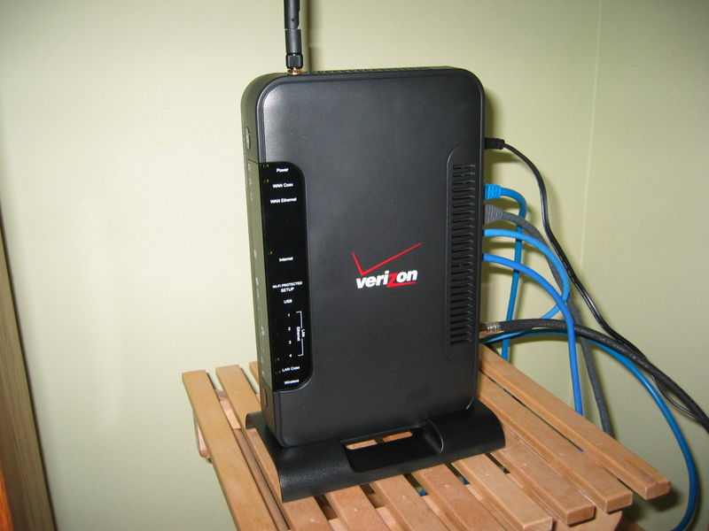
Connecting to the Internet
Picture Source: http://mythman.typepad.com/.a/6a00d834520f3b69e20111688d4149970c-800wi
End users get connectivity from an ISP (internet service provider)
Home users use dial-up, ADSL, cable modems, satellite
Businesses use dedicated circuits connected to LANs
ISPs use “wholesalers” called network service providers and high speed (T-3 or higher) connections

Slide 28
Getting a Packet through the Network
Need addresses that are globally unique
And some way to find them →
Need network devices that know about other network devices
Need a routing algorithm for finding a path
Need a mechanism for accommodating diverse networks
Many more details ⇒

Slide 29
IP Header
Slide modified from Agrawal

Slide 30
IP datagram format
IP protocol version
number
32 bits
total datagram
length (bytes)
header length
(bytes)
head.
len
type of
service
ver
length
for
fragmentation/
reassembly
“type” of data
flgs
fragment
offset
16-bit identifier
max number
remaining hops
(decremented at
each router)
time to
live
upper
layer
header
checksum
32 bit source IP address
upper layer protocol
to deliver payload to
32 bit destination IP address
Options (if any)
E.g. timestamp,
record route
taken, specify
list of routers
to visit.
how much overhead with TCP?
20 bytes of TCP
20 bytes of IP
= 40 bytes + app layer overhead
data
(variable length,
typically a TCP
or UDP segment)

Slide 31
IP Datagram Format
First Word purpose: info, variable size header & packet.
Version (4 bits)
IPv4 and IPv6
Internet header length (4 bits): units of 32-bit words. Min header is 5 words or 20 bytes.
Type of service (TOS: 8 bits): Reliability, precedence, delay, and throughput
Not strictly used
Total length (16 bits): header + data. Units of bytes. Total must be less than 64 kB.

Slide 32
IP Header (Continued)
2nd Word Purpose: fragmentation
Identifier (16 bits): Helps uniquely identify the datagram between any source, destination address
Flags (3 bits): More Flag (MF):more fragments , Don’t Fragment (DF) ,Reserved
Fragment offset (13 bits): In units of 8 bytes

Slide 33
IP Header (Continued)
Third word purpose: demuxing, error/looping control, timeout.
Time to live (8 bits): Specified in router hops
Protocol (8 bits): Next level protocol to receive the data: for de-multiplexing.
Header checksum (16 bits): 1’s complement sum of all 16-bit words in the header.
Change header => modify checksum using 1’s complement arithmetic.

Slide 34
Throughput
Mac OS X Definition: “the amount of material or items passing through a system or process”
IP Header has at least 5 x 32 = 160 bits (20 bytes)
Ethernet or WiFi header and CRC have their own bits
WiFi has waiting times, backoff
TCP segment has its own header!
What is the application level data rate?
Typically called throughput at various layers
Bits/sec, packets/sec, packets/time slot, etc.

Slide 35
Internet (IP) Addresses
When an organization connects to the Internet, it obtains a set of IP addresses for its computers
The current addresses consist of 32 bit binary numbers (IPv4)
Theoretically up to 2³² = 4.29 billion addresses
IPV6 expands the address space
Routing each address uniquely would
Require enormous routing tables and take a lot of time
Solution: allocate addresses in blocks

Slide 36
IP Addresses
Binary numbers are hard to remember, so use decimal equivalents
Divide decimal digit string into four sets of numbers separated by “dots”
136.142.185.57
Translate into binary
Decimal to Binary
Convert decimal to sum of binary exponents (0-7): 2⁷=128, 2⁶=64, 2⁵=32, 2⁴=16, 2³=8, 2²=4, 2¹=2, 2⁰=1
136=128+8= 2⁷+ 2³
142=128+8+4+2= 2⁷+ 2³+ 2²+ 2¹
10001000 10001110 10111001 00111001

Slide 37
Original IP Address Blocks
Block sizes
Big users (Class A) – 128 available, each for 16 million hosts
Medium users (Class B) - 16,384 available, each for 65,000 hosts
Small users (Class C) - 2 million available, each for 256 hosts
Group of addresses assigned by ICANN: Internet Corporation for Assigned Names and Numbers

Slide 38
IP Addresses
Class A
0
netid = 7 bits
hostid
Class B
1
0
netid = 14 bits, 2¹⁴ = 16384
hostid
Class C
1
1
0
netid
hostid = 8 bits

Slide 39
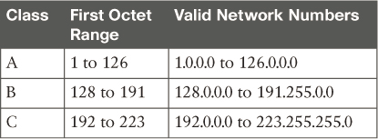
All Possible Valid Network Numbers

Slide 40
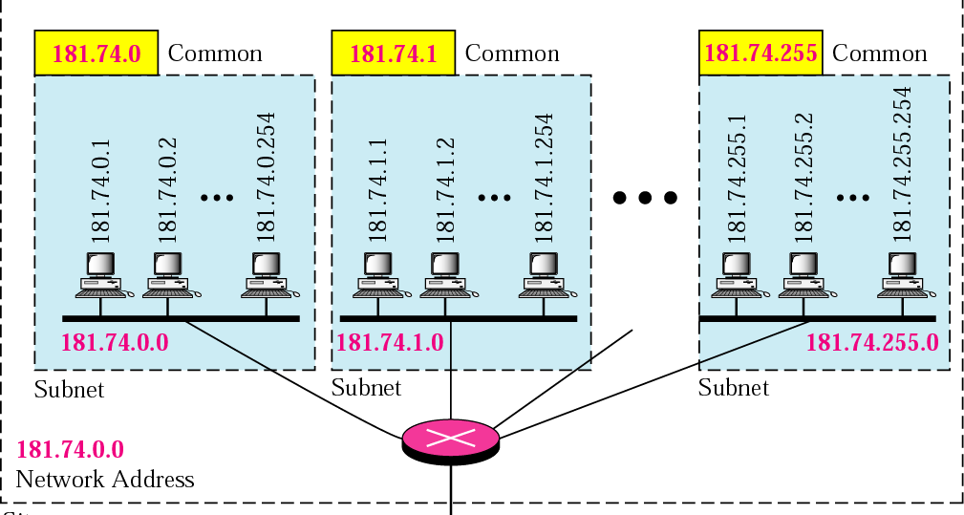
Networks, Subnets & Addresses
Source: Forouzan
Allows for the subdivision of networks within an organization
Each LAN can have a subnet number, allowing routing among networks
Host ID portion is partitioned into subnet and host numbers

Slide 41
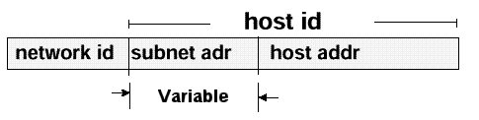
Subnets
Often want 3 divisions:
subnet = front part of host id
6 bits for Subnet
10 bits for host
How many possible subnets?
How many possible hosts?
Host ID is divided in two parts
Boundary
determined
by Class
Subnet mask
32-bit number that tells the router how to separate the host address and the network address
Shown for
Class B
=255.255.252.0

Slide 42
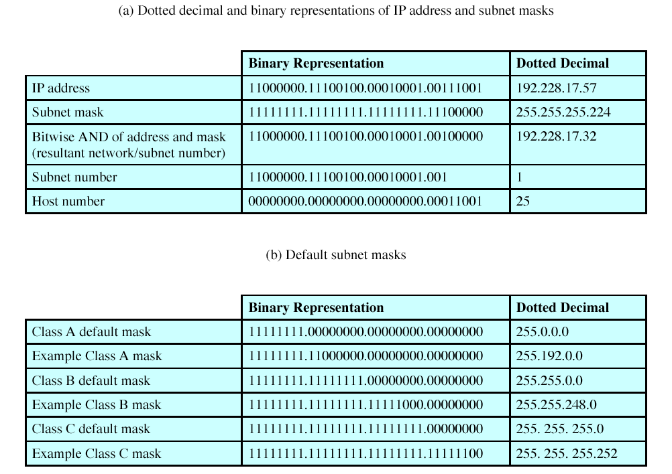
Subnet Mask Calculations
Subnet Mask: 32-bit number that tells the router how to separate the host address and the network address
Source: Stallings

Slide 43
IP addressing: CIDR
CIDR: Classless Inter Domain Routing
Address class is no longer uniquely identifiable from the address
Subnet portion of address of arbitrary length
Address format: a.b.c.d/x, where x is # bits in subnet portion of address
Subnet part
Host part
11001000 00010111 00010000 00000000
verify
200.23.16.0/23

Slide 44
IP addresses: How does a Network get one?
Q: How does a network get subnet part of IP addr?
A: gets allocated portion of its provider ISP’s address space
ISP's block 11001000 00010111 00010000 00000000 200.23.16.0/20
Organization 0 11001000 00010111 00010000 00000000 200.23.16.0/23
Organization 1 11001000 00010111 00010010 00000000 200.23.18.0/23
Organization 2 11001000 00010111 00010100 00000000 200.23.20.0/23
... ….. …. ….
Organization 7 11001000 00010111 00011110 00000000 200.23.30.0/23

Slide 45
Hierarchical addressing: route aggregation
Hierarchical addressing allows efficient
advertisement of address for routing information:
Organization 0
200.23.16.0/23
Organization 1
*
200.23.18.0/23
“Send me anything
with addresses
beginning
200.23.16.0/30”
Organization 2
200.23.20.0/23
.
ISP – A+
.
.
.
.
Internet
Organization 7
.
200.23.30.0/23
ISPs-R-Us
“Send me anything
with addresses
beginning
199.31.0.0/16”
Notes:
Two important facts about how IPv4 groups IP addresses:
All IP addresses in the same group must not be separated from each other by a router.
IP addresses separated from each other by a router must be in different groups

Slide 46
A Summary of Router Forwarding Logic
1. Use the data-link Frame Check Sequence (FCS) field to ensure that the frame had no errors; if errors occurred, discard the frame.
2. Assuming that the frame was not discarded at Step 1, discard the old data-link header and trailer, leaving the IP packet.
3. Compare the IP packet’s destination IP address to the routing table and find the route that best matches the destination address. This route identifies the outgoing interface of the router, and possibly the next-hop router IP address.
4. Encapsulate the IP packet inside a new data-link header and trailer, appropriate for the outgoing interface, and forward the frame.

Slide 47
IP Forwarding (I)
Source & Destination in same network (direct connectivity)
Recognize that destination IP address is on same network
Use subnet mask for this purpose
Find the destination LAN (MAC) address
Use Address Resolution Protocol (ARP) for this (later)
Send IP packet encapsulated in LAN frame directly to the destination LAN address
Encapsulation => source/destination IP addresses don’t change

Slide 48
IP Forwarding (II)
B) Source & Destination in different networks (indirect connectivity)
Recognize that destination IP address is not on same network.
Look up destination IP address in a (L3 forwarding) table to find a match, called the next hop router IP address.
Send packet encapsulated in a LAN frame to the LAN address corresponding to the IP address of the next-hop router.

Slide 49
IP Forwarding: Example Scenario
routing table in A
Dest. Net. next router Nhops
223.1.1 1
223.1.2 223.1.1.4 2
223.1.3 223.1.1.4 2
misc
fields
source
IP addr
dest
IP addr
data
A
223.1.1.1
datagram remains unchanged, as it travels source to destination
addr fields of interest here
223.1.2.1
223.1.1.2
223.1.1.4
223.1.2.9
B
223.1.2.2
E
223.1.1.3
223.1.3.27
223.1.3.1
223.1.3.2

Slide 50
IP Forwarding (Direct)
A,B are directly connected
Dest. Net. next router Nhops
misc
fields
223.1.1.1
223.1.1.3
data
223.1.1 1
223.1.2 223.1.1.4 2
Starting at A, given IP datagram addressed to B:
* look up network address of B
* find B is on same network as A
* link layer will send datagram directly to B inside link-layer frame
223.1.3 223.1.1.4 2
A
223.1.1.1
223.1.2.1
223.1.1.2
223.1.1.4
223.1.2.9
B
223.1.2.2
E
223.1.1.3
223.1.3.27
223.1.3.1
223.1.3.2

Slide 51
IP Forwarding (Indirect): 1
A, E not directly attached
misc
fields
Dest. Net. next router Nhops
223.1.1.1
223.1.2.2
data
223.1.1 1
223.1.2 223.1.1.4 2
Starting at A, dest. E:
* look up network address of E
* E on different network
* routing table: next hop router to E is 223.1.1.4
* link layer sends datagram to router 223.1.1.4 inside link-layer frame
* datagram arrives at 223.1.1.4
continued…..
223.1.3 223.1.1.4 2
A
223.1.1.1
223.1.2.1
223.1.1.2
223.1.1.4
223.1.2.9
B
223.1.2.2
223.1.1.3
223.1.3.27
E
223.1.3.1
223.1.3.2

Slide 52
IP Forwarding (Indirect): Step 2
Dest. next
misc
fields
network router Nhops interface
223.1.1.1
223.1.2.2
data
223.1.1 - 1 223.1.1.4
Arriving at 223.1.1.4, destined for 223.1.2.2
* look up network address of E
* E on same network as router’s interface 223.1.2.9
router, E directly attached
* link layer sends datagram to 223.1.2.2 inside link-layer frame via interface 223.1.2.9
* datagram arrives at 223.1.2.2
223.1.2 - 1 223.1.2.9
223.1.3 - 1 223.1.3.27
A
223.1.1.1
223.1.2.1
223.1.1.2
223.1.1.4
223.1.2.9
B
223.1.2.2
E
223.1.1.3
223.1.3.27
223.1.3.1
223.1.3.2

